Slide 1
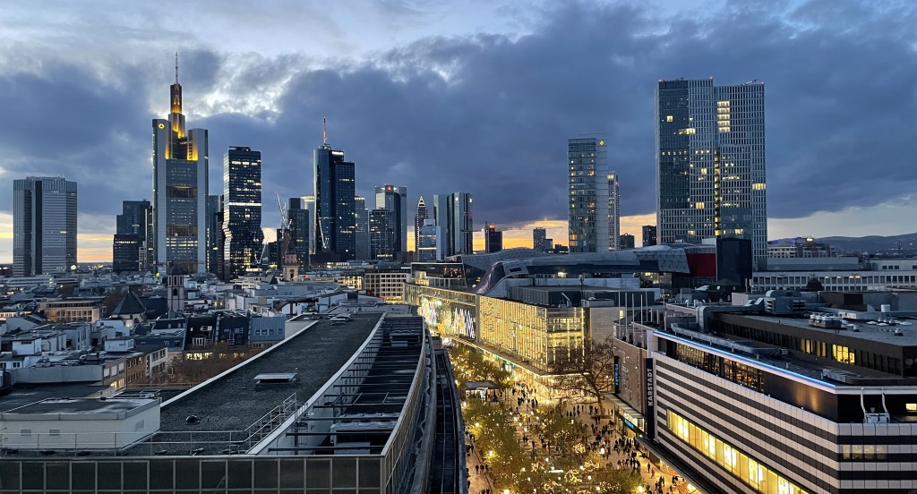
German Real Estate Market Overview 2022
Analysis and Forecast
Ralf-Peter Koschny
ULI Japan Webinar
12 February 2022

Slide 2
Germany‘s Real Estate Market 2022 – Implications for the Real Estate Industry
Key national economic figures -
driving our forecasts for office, logistics, residential and retail.
Pre-crisis level of the national economy will be reached in the course of 2022
Consequences of the pandemic will have rather a long-term effect, short-term: strong demand meets supply bottlenecks
Home Office with little effect on office demand
Online Retail with dynamic growth
Development of inflation and interest rate viewed carefully, potential price-wage spiral
Increase of the legal minimum wage by 25% has effects on managed properties like hotel, senior living and retail
Demographic change as an opportunity, (retirees consume), but also labour shortage
ESG: Climate protection leads to higher ef-forts in buildings: more requirements, but also more opportunities regarding refurbish-ment, higher costs in existing buildings
Strong increase in construction and land costs can impact both ,new developments and refurbishment of stock
Positive employment development with positive effects on all real estate sectors, especially for offices
Source: bulwiengesa AG

Slide 3
German Assets of Institutional Investors Germany, 2021, Total of 585 Billion Euro
»
31 %
of Germany‘s institutional real estate is held by foreign investors
Source: BVI, BAFin, BdL, Deutsche Bundesbank-Kapitalmarktstatistik, survey bulwiengesa AG

Slide 4
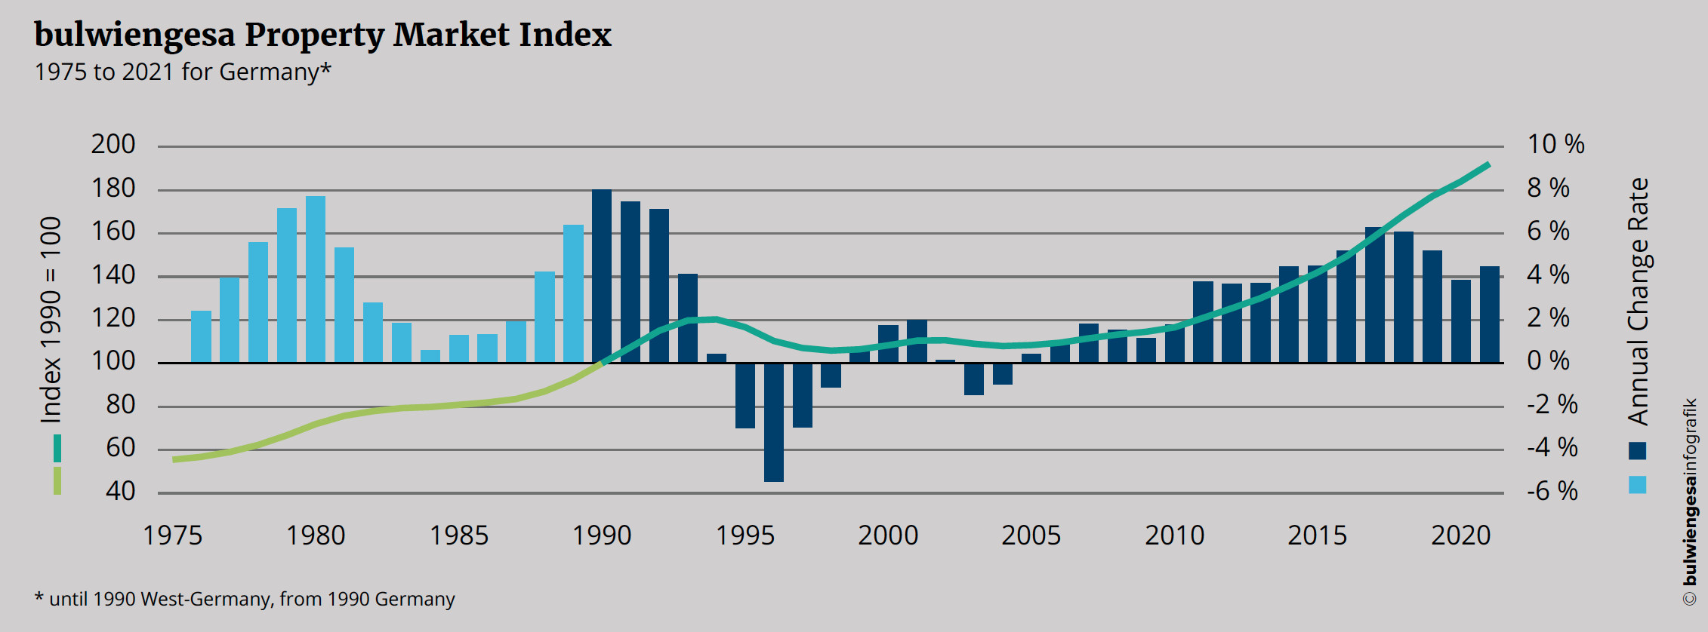
Germany‘s Real Estate Market Status 2021/22 Long Time Price and Rent Index – ‚Continuous Upswing‘ in General
Source: bulwiengesa AG

Slide 5
Real Estate Sentiment and -Crisies in Germany 2008 – 2021 by Asset Class (until December 2021)
Global Crisis
Financial Markets
Curreny Troubles EURO
Potential War
in Ukraine
First Lockdown COVID-19
Source: bulwiengesa / Deutsche Hypo – asked, how the upcoming six months compare to the past six months
5

Slide 6
No decline in office employment development expected
»
Slight increase since 2021
The growth is less dynamic
∆ 2020 – 2025
Berlin | 8,6 %
Düsseldorf | 5,9 %
Frankfurt | 5,5 %
Hamburg | 5,9 %
Köln | 6,7 %
München | 5,9 %
Stuttgart | 4,6 %
Source: bulwiengesa, Autumn Forecast 2021
Notes:
Auf dieser Folie kann man gut sehen,dass insbesondere die A-Städte vom Zuzug hochqualifizierter Arbeitskräfte profitierten und ein entsprechend hohes Bürobeschäftigtenwachstum erfahren haben.
2020 wird eine Stabilisierung der Zahlen erwartet. Vor dem Hintergrund der Fachkräftemangels versuchen Unternehmen ihre Beschäftigten zu halten. In diesem Zusammenhang ist natürlich auch das Instrument der Kurzarbeit zu nennen.
Bis 2024 durchschnitltliches Wachstum von 1,0 % p. a. bei den A-Städten (letzte 5 Jahre 2,4 %)
Und 0,3 % bei den B-Städten (1,1 %)
Damit verliert die Entwicklung deutlich an Dynamik. Anzeichen dafür gab es aber schon vor der Corona-Pandemie

Slide 7
Peaks in building completions expected for 2022 and 2023
»
Among the A-cities, Berlin concentrates
40 % of construction activity
Source: bulwiengesa, Autumn Forecast 2021, *New Construction + Development

Slide 8
Office: The market for office real estate remains stable
Prime rent (EUR/sqm total rental space) weighted average
Source: bulwiengesa, Autumn Forecast 2021

Slide 9
Returns still under pressure
»
Larger returns expected only with increase in interest rates
Returns 2021
Berlin | 2,5 %
Düsseldorf | 2,9 %
Frankfurt | 2,8 %
Hamburg | 2,6 %
Köln | 3,0 %
München | 2,6 %
Stuttgart | 3,0 %
Source: bulwiengesa, Autumn Forecast 2021

Slide 10
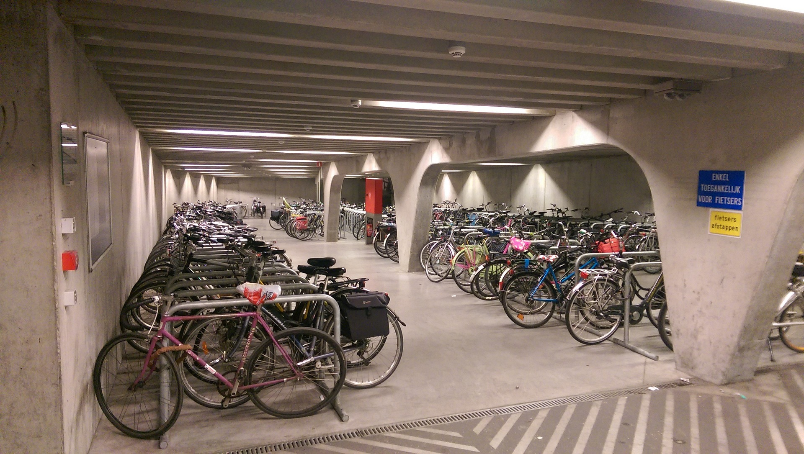



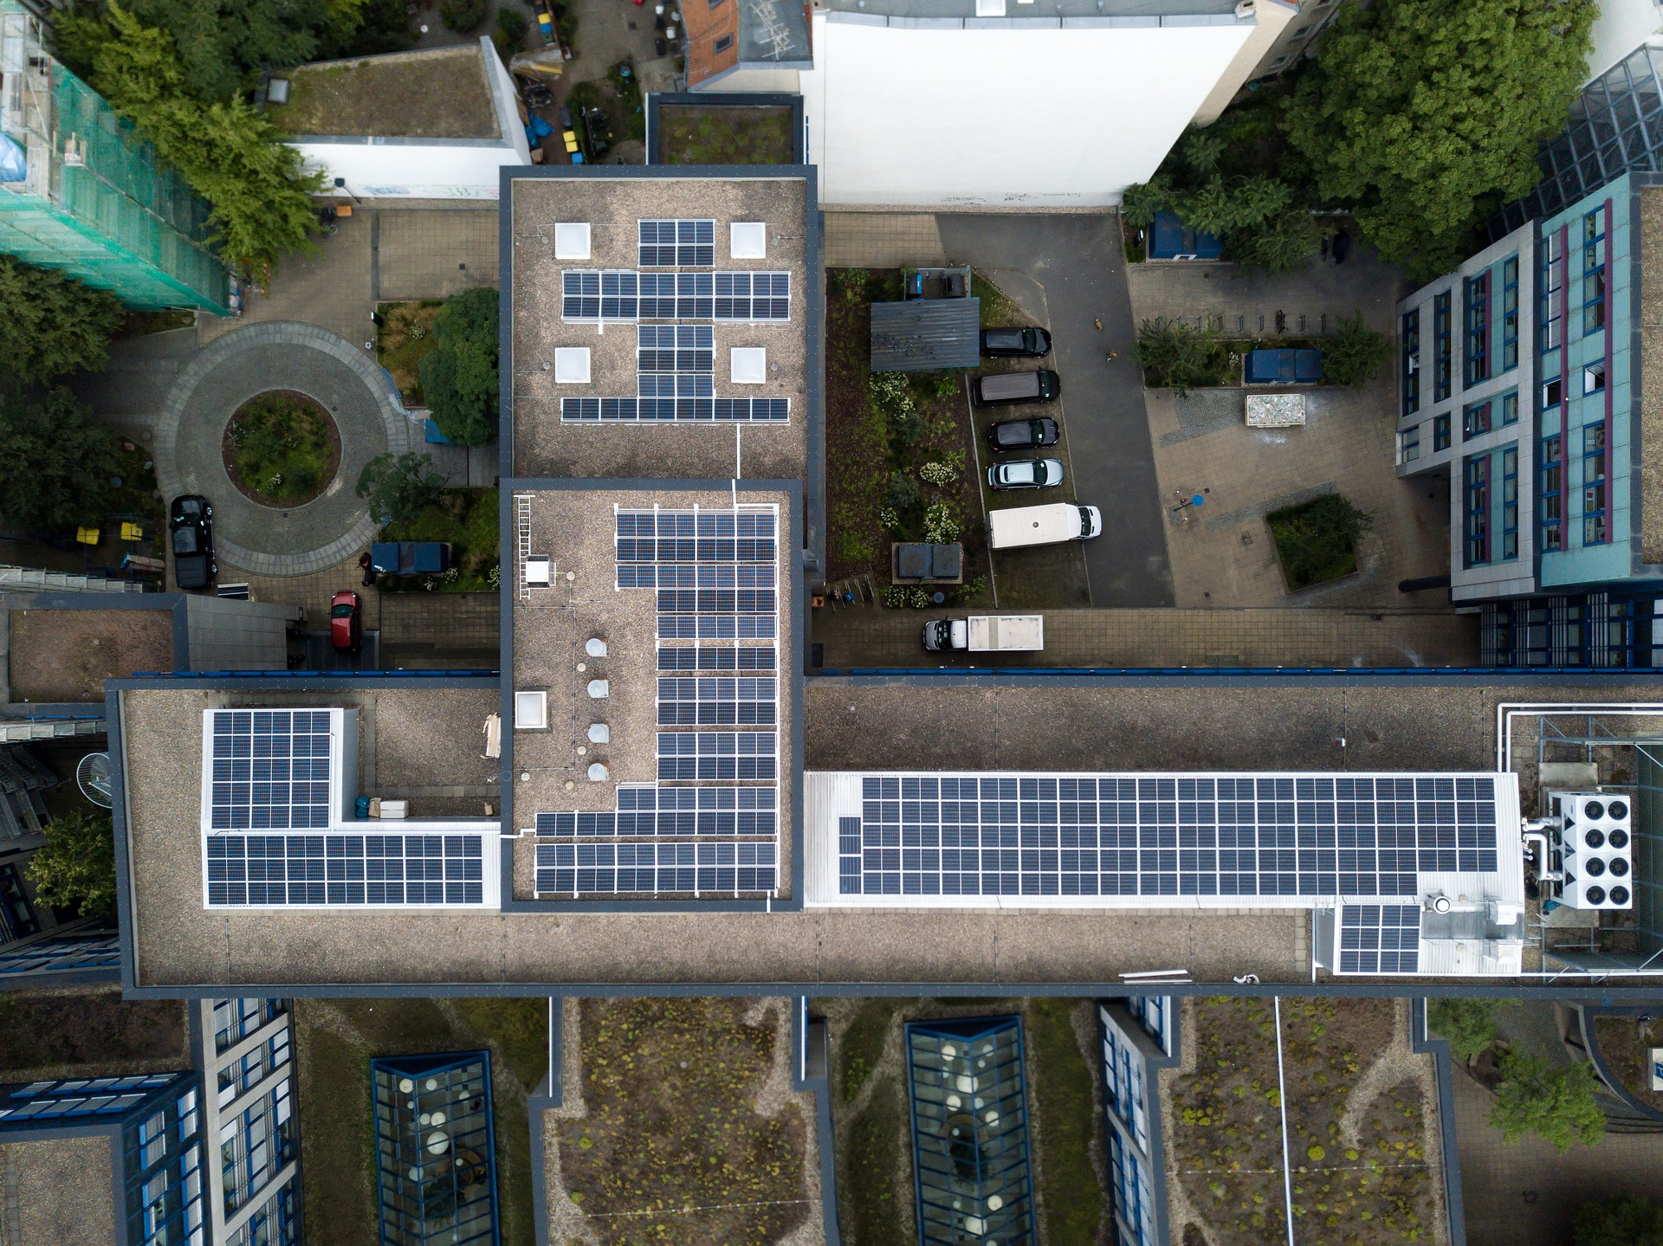
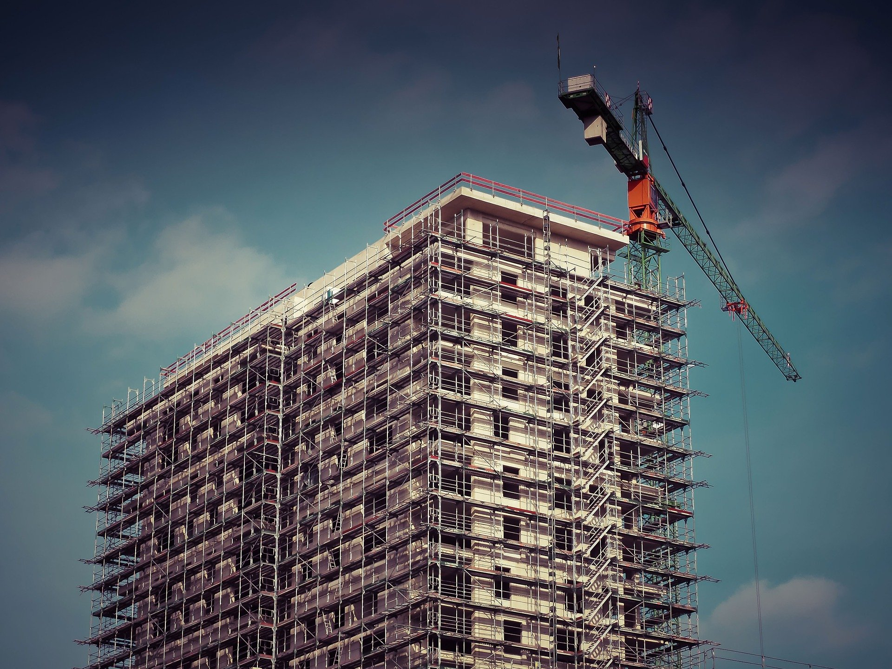
Offices are still needed...
Market environment
Requirements profile for offices is changing
War of Talents
End of Trip Facilities
New office concepts
ESG…
will have greater impact on office market than home office
is/will also be the defining issue in the investment market and lead to increased return spreads between core and non-core
Market figures
Tenants and Renters back on an equal footing in tight markets
Vacancy rate increases; Relevance of sublease space increases
Nominal rents stable to slightly falling; effective rents falling
Lack of construction capacity and high construction costs with enormous impact on pipeline - postponements possible
Price pressure on objects with quality defects increases

Slide 11
Logistic: 2021 Investments back at 'pre-crisis' level
Corporate Real Estate:
at least
3.8
Billion Euro
in further investments on the industrial market in 2021
Source: bulwiengesa

Slide 12
Rents continue to rise in all city categorie
Top locations
with strongest forecast growth of
+ 10 %
»
Due to shortage of space, also demand for well-connected sites in peri-pheral loca-tions
Forecast
Source: bulwiengesa

Slide 13
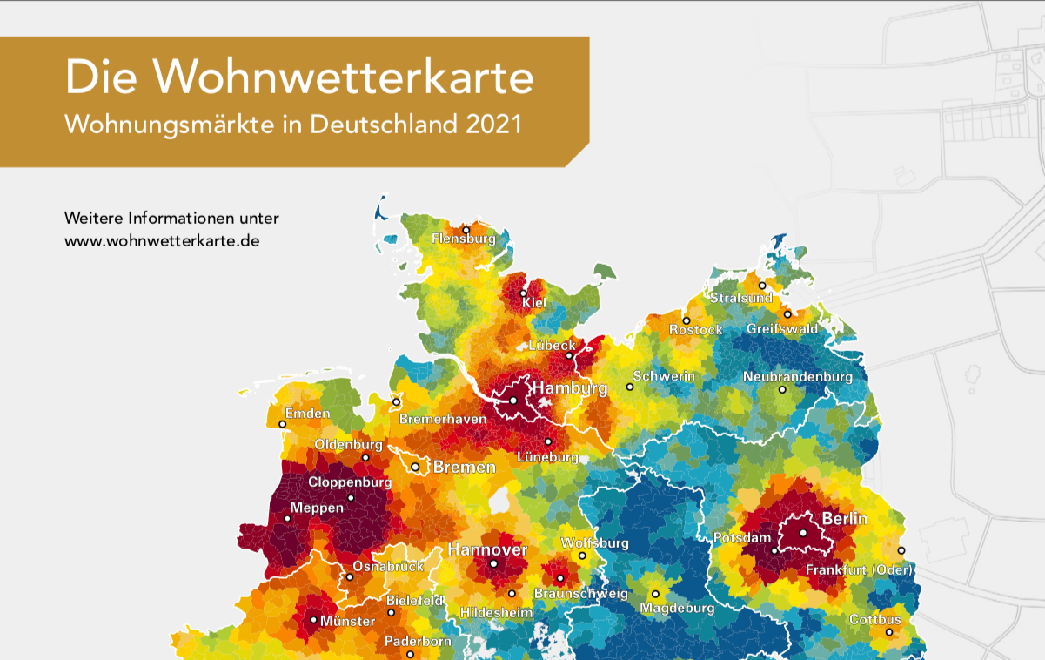
Residential Activity Northern Germany 2021
Heat Map Residential Demand
in Germany 2021
Further information at
www.wohnwetterkarte.de
Source: BPD, bulwiengesa

Slide 14
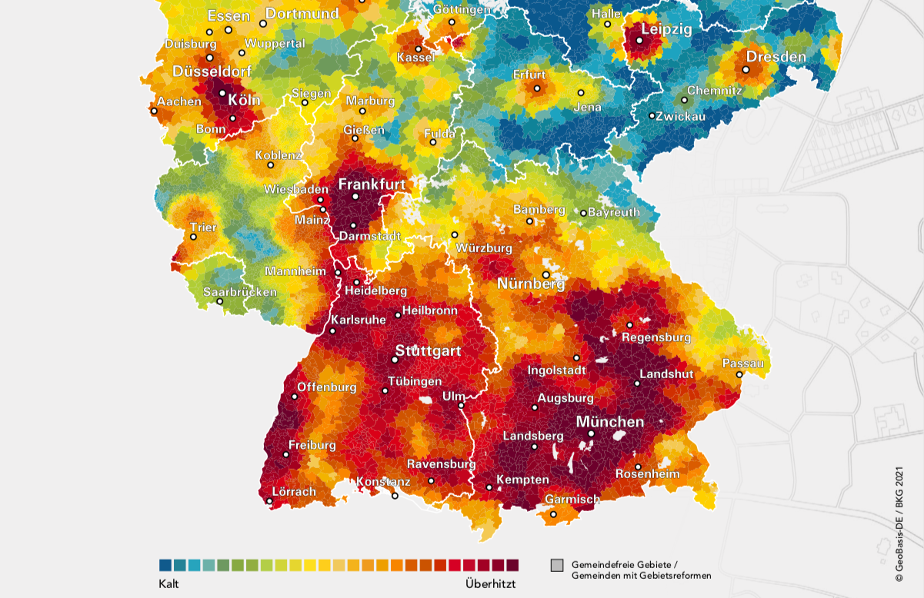
Residential Activity Southern Germany 2021
Municipality-free areas/ municipalities with territorial reform
Cold
Overheated
Source: BPD, bulwiengesa

Slide 15
Retail: Indexed Development of Retail Sales in Germany – Decoupled Dynamics in Internet Retailing
»
Mail order/internet trade expected to generate 85 billion euros* in sales in 2021, around 15% of total retail sales
»
Stationary retail with sales of around 508 billion euros* in 2021
1. Lockdown
2. Lockdown
Source: Federal Statistical Office, retail sales, real, calendar- and seasonally adjusted, 2015 = 100, as of Nov. 24, 2021, *preliminary data.

Slide 16
Retail sales up again in 2021
»
Growth rates lower than in 2020, fashion retail and furnishings/building supplies down
»
Optimism exists for retail sales to rise again
Source: Federal Statistical Office, HDE, *nominal
16
16

Slide 17

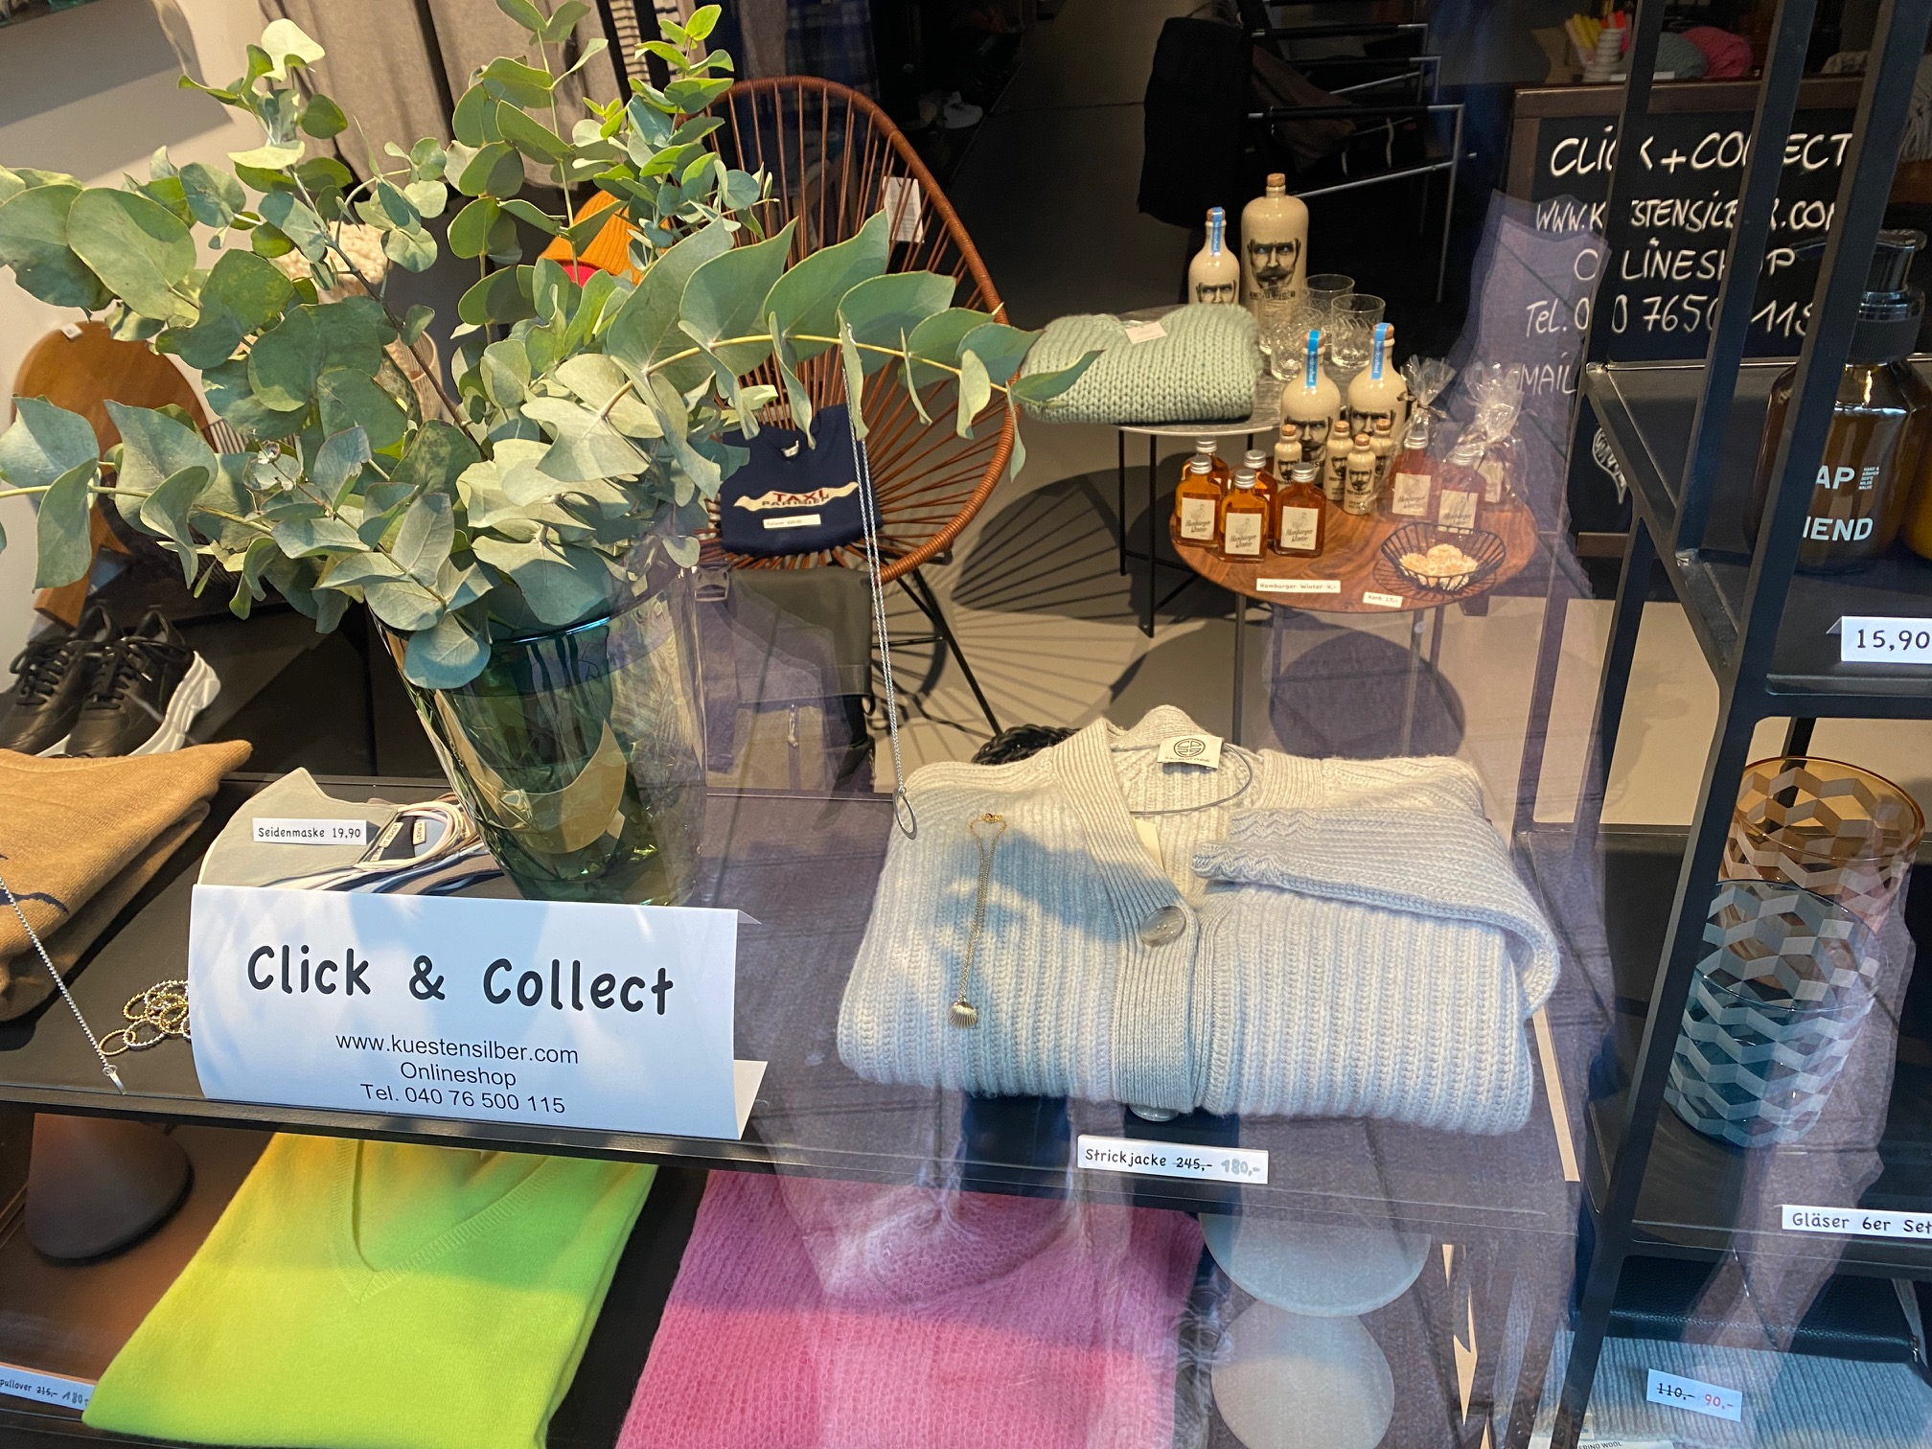

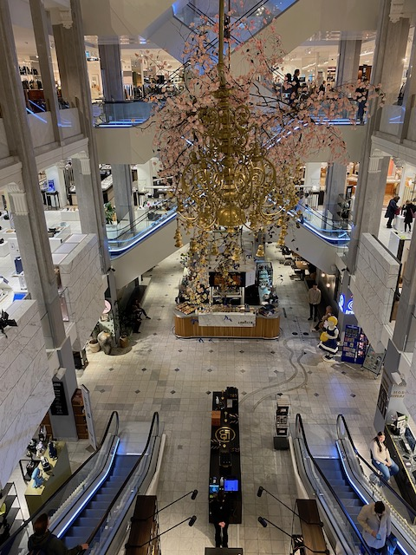



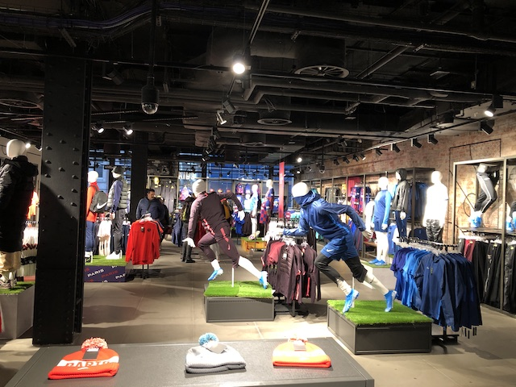

Stationary fashion retail, however, sales to decline again in 2021
Stationary fashion retail* with sales losses 2021: - 8.3 % compared with previous year
Internet trade with fashion with sales gains 2021: + 12.0 % vs. previous year
Just under 60 % of fashion sales are generated in stationary fashion retail
Quarter 4/2021 exceedingly strong with 33% increase compared to quarter 4/2020
Decline in sales slowed in 2nd half of 2021
Desire to buy fashion in bricks-and-mortar stores persists, with customers returning quickly as access restrictions decline
Fashion retail profitability continues to suffer, however
Foto: bulwiengesa
Source: Statistisches Bundesamt, HDE, Wertangaben jeweils nominal, TW-Testclub, *Textilien, Mode, Schuhe, Lederwaren, ohne Mode bei branchenfremden Anbietern

Slide 18
Prime rents in high-street locations remain under pressure
»
Decline in rents in 1a locations has been recorded since 2017
3,2 %
Annnual rental growth in food retail since 2016
Source: RIWIS, bulwiengesa AG

Slide 19
The expansion of shopping centers is coming to a standstill...
»
In 2022 there will be 4 new openings, 2 of which will be neighborhood developments
»
Überseequartier (ÜSQ, Oversea-quarter in engl.) in Hamburg is last major new development, (Shopping Center is component of the quarter, opening ca. 2024)
+ 178 5 more area since 2010
Source: EHI Shopping Center Report, total area corresponds to rental area plus mall area

Slide 20
